Slide 1
Research of utilization of wood as renewable raw material in Slovakia
Martin Moravčík, Miroslav Kovalčík, Hubert Paluš,
Ján Parobek, Vlastimil Murgaš
Odborná konferencia
“Aktuálne otázky ekonomiky a politiky lesného hospodárstva SR“
Národné lesnícke centrum – Lesnícky výskumný ústav, 13. decembra 2017
Notes:
This presentation relates to the „Research of utilization of wood as renewable raw material in Slovakia“ and it is based on the preliminary results of the ongoing research project funded by the Agency for the support of research and development in Slovakia.

Slide 2
Objective of the scientific project and the content of the presentation
The main objective of the scientific project is to create:
an optimal model of wood utilization in Slovakia.
The creation of the optimal model of wood utilization requires some preparatory and analytical work, mainly:
the stipulation of main product categories, levels and methods of processing and use of wood,
analysis and quantification of current material flows of wood and
identification and analysis of key factors affecting the use of wood in Slovakia.
Notes:
....
In order to secure this objective it is necessary to carry out some preparatory and analytical work, ...

Slide 3
Simplified structure of wood flows in Slovakia
WOOD SOURCES |  |  | WOOD USE
PRIMARY | SECONDARY | SEMI-FINISHED PRODUCTS FLOW | WASTE FLOW | ENERGY FLOWS
SAWNWOOD
WASTE FROM SAWMILL OPERATION
ENERGY
SAWLOGS
PELLETS
RECOVERD PAPER
WASTE FROM PULP AND PAPER INDUSTRY
PULP WOOD
WOOD PULP AND PAPER
INTERNAL USE IN WOOD- PROCESSING INDUSTRY
RECYCLED WOOD
FUEL WOOD AND CHIPS
WOOD-BASED PANELS
WASTE FROM WOOD- BASED PANELS PRODUCTION
Notes:
For the needs of our research, following the analysis of use of wood resources in Slovakia, we designed this very simplified structure of the basic wood flows.
The proposed structure of the model covers the flows of the three main groups of raw wood assortments: (i) sawlogs, (ii) pulpwood, (iii) fuelwood and separate flow of forest chips.
The wood flows cover the primary and secondary sources on one side, and their utilization on the other side through the flows of material (semi-finished products), waste and energy.
In the analysis of individual material flows the apparent consumption (production + import – export) is taken into the account.

Slide 4
Analysis of key factors affecting the utilization of wood in Slovakia
The extent of wood utilization in the different wood-processing industries varies depending on many external and internal factors, in particular:
Wood production:
Available structure of assortments of timber raw material.
Legal restrictions on producers of raw timber
Level of technical infrastructure of forestry.
Forestry and environmental state policy in the area of ​​exploitation of forest resources.
The impact of climate change on the structure of forest stands, especially tree species.
Wood processing and use:
State policy on wood processing and use.
Technical level of the wood-processing industries; support for research and innovation.
Competitiveness of wood against fossil fuels and other RES.
Restrictions on processors of raw wood, recycled wood and paper
Supply chain:
Accessibility and transparency of information on the production, purchase and distribution of wood from producers to processors and consumers.
Quality of the market environment.
Notes:
For solution of this task we carry out analyses of different external and internal factors in the fields of 1) wood production, 2) wood processing and use and 3) supply chains. On this slide there is displayed the list of mentioned key factors.

Slide 5
Content of presentation
This presentation provides some results of the analyses on:
the production potential of Slovak forests and the prognosis of its development,
with a particular attention paid to
possibilities of wood felling,
its tree species composition
share of the quality grades of wood assortments,
average domestic and export prices.
the creation of the optimal model(s) of sustainable wood utilization in Slovakia.
Notes:
In accordance with the approved abstract for this scientific conference our presentation provides some results of the analyses on: ...

Slide 6
Sources of information
The mentioned analyses are based on the data originating from following sources of information:
Summary information on forests obtained from data of the forest management plans (FMP);
National Forest Inventory and Monitoring (NFIM) of the Slovak Republic, based on a mathematical and statistical methods of surveying the state and development of forests;
Socio-economic and production information on forestry including wood-processing and pulp industry;
Own research findings.

Slide 7
Data obtained from FMP (Summary information on forests)
Forest Management Plans (FMP) are the main source of the basic information on forests in Slovakia at present.
The FMP contains two main parts:
forest stand description and
plan of management measures.
Within the forest stand description there are found out all main indicators of the forest state in all forest stands (subcompartments)
This data is preferentially needed for the purposes of forest management planning
But because in Slovakia there is still valid the basic principle that FMP must be elaborated for all forests in the country,
we are able to obtain the Summary Information on Forest Status also by summarisation of the data that were found out within the stand description.
Notes:
Forest Management Plans are the main source of the basic information on forests in Slovakia at present. They result from the forest stands description.

Slide 8
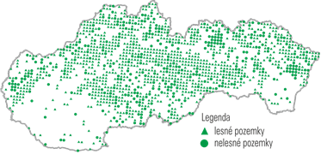
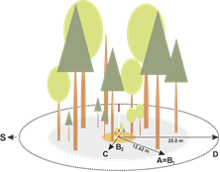
National Forest Inventory and Monitoring (NFIM) in Slovakia
Data is collected on systematically allocated terrestrial inventory plots by direct measurement.
There is used:
4 x 4 km sampling grid,
500 m2 area of inventory plot,
1 inventory plot represents 1,600 ha,
Totally 1,486 inventory plots were established.
Notes:
Another source of information is NFIM.

Slide 9
National Forest Inventory and Monitoring
The 1st cycle of the National Forest Inventory and Monitoring (NFIM) on statistical basis was performed in 2005-2006
The 2nd cycle was performed in 2015-2016
Through this method we found out, in addition to standard data, also data on a few new indicators which are missing in the data from the FMP: for example: dead wood, forest naturalness, data on forests on other land, carbon sequestration, timber felling.
Data from both inventory methods (NFIM and FMP) are suitably complemented each other – despite there were found out considerable differences between them.
After the 2nd cycle of the NFIM 2015-2016 we have obtained not only actual data, but we have found out the trends of development during the last ten years.

Slide 10
Forest area and Forest percentage
Indicator | NFIM | FMP
Forest on forest land (ths. ha) | 1 924 ± 54 | 1 923,4
Forest on non-forest land (ths. ha) | 288 ± 39 | n.a.
Dwarf pine stands (ths. ha) | 24 ± 6 | 20,8
Unstocked forest land (ths. ha) | 59 ± 7 | 72,6
Forest percentage without dwarf pine (%) | 39,2 | 39,6
Forest percentage including forest on non-forest land (%) | 45,1 | n.a.
Notes:
On this slide you can see data on forest area and forest percentage collected through the both methods: NFIM and FMP. In addition to forests on forest land there were found out about 288 ths. ha of forests on the non-forest land in Slovakia within the NFIM. The forest percentage in Slovakia including forests on non-forest land is more than 45%.

Slide 11
Tree species composition (%)
European beech is the most represented tree species, followed by Norway spruce and Oaks in forests on forest land
In forests on non-forest land are most represented tree species: Other broadleaves
Tree species (aggregated) | NFIM - FL | FMP | NFL
Norway spruce | 19,6 ± 2,2 | 23,1 | 12,9 ± 4,5
silver fir | 3,2 ± 1,0 | 4,1 | 0,4 ± 0,8
pines | 5,0 ± 1,2 | 6,8 | 5,4 ± 3,0
other conifers | 1,9 ± 0,8 | 3,6 | 0,1 ± 0,4
European beech | 33,4 ± 2,7 | 33,5 | 7,8 ± 3,6
oaks | 10,6 ± 1,7 | 10,6 | 6,6 ± 3,3
hornbeam | 7,9 ± 1,5 | 5,9 | 12,4 ± 4,4
valuable broadleaves | 8,1 ± 1,5 | 4,5 | 10,1 ± 4,0
other broadleaves | 10,2 ± 1,7 | 7,9 | 44,4 ± 7,3
total conifers | 29,8 ± 2,6 | 37,6 | 18,8 ± 5,3
total broadleaves | 70,2 ± 2,7 | 62,4 | 81,2 ± 7,6
Notes:
1) In forests of Slovakia the European beech...
2) Tree species composition is find out through both methods and there are occurred certain differences. According to FMP the conifers are a little overvalued and on the contrary broadleaves are undervalued.

Slide 12
Volume of growing stock in million m³ with d_{bh} ˃ 7 cm under bark
Total growing stock according to NFIM is about 583 mill. m3; it is about 100 mill. m3 more than volume of growing stock according to FMP (481 mill. m3).
Volume of growing stock in forests on non-forest land is about 46 mill. m3.
 | NFIM - FL | FMP | NFL
total conifers | 215,0 ± 16,3 | 202 | 13,7 ± 3,5
of that Norway spruce | 143 ± 13,8 | 134 | 10,3 ± 3
total broadleaves | 367,7 ± 18 | 278 | 31,8 ± 5,5
of that European beech | 219,3 ± 14,9 | 169 | 4,9 ± 2,5
of that oaks | 67,9 ± 7,5 | 46 | 2,7 ± 1,3
total growing stock | 583 ± 23 | 481 | 46 ± 7

Slide 13
Development of the growing stock volume in million/thousand m³ with d_{bh} ˃ 7 cm under bark
Volume of growing stock has been increasing in long term - during last ten years by 8,3%.
This trend results mainly from development of volume of broadleaved tree species growing stock.
Volume of conifer growing stock has been decreasing since about 2010.
On the right handed picture is development of growing stock by the age classes.

Slide 14
Age composition of forests and its development
The main reason of the before mentioned increase of volume of timber growing stock in Slovakia is the current uneven age composition with over normal share of forests older than 70 years (age classes: 8th plus) - (picture on left handed side).
On the picture on right handed side is the development of the age composition by age classes in ha since 1970.

Slide 15
Development of timber felling (planned, actual, incidental) compared with total current increment
Gradual increase of planned felling (blue line) due to current age composition.
Permanently higher volume of annual felling (red line) as compared with planned felling due to high volume of incidental felling (grey line).
Lower volume of actual felling as compared to volume of total current increment (yellow line).
Notes:
Due to current state and development of forests we can observe ...

Slide 16
Growing stock and its distribution by the quality grades of assortments
Share of the quality grades of timber assortments in Slovakian forests according to:
Conifers – green colour
Broadleaves – brown colour
found out by FMP (light colour) and NFIM (dark colour).
Quality grades:
I-III quality grade logs
IV – e.g. mining timber, poles
V – pulpwood
VI – energy, fuelwood
Differences between both sources are most to 4%.
Notes:
Distribution of volume of growing stock in Slovakian forests onto quality grades of wood assortments we have found out separately for both conifers and broadleaves from the both information sources: FMP and NFIM.
Within this analysis we obtained data for quality grades differentiated into 3 categories of quality grades logs (I, II, IIIA and IIIB), the fifth grade – pulpwood and the sixth grade – energy and fuelwood.
Differences between both information sources – from FMP and NFIM – are most to 4%.

Slide 17
Share of quality grades of assortments: „potential - in planned felling“ and „real – after realized felling“
We do not reach the potential share of quality grades of assortments:
The share of the I-III grade logs (more valuable) is lower in real.
The share of less valuable assortments V (pulpwood) and VI (fuelwood) is higher.
But there are about 10% (in conifers) and 2% (broadleaves) of wood sold as raw stems within which we do not know the shares of quality grades.
Notes:
Based on the comparison of share of quality grades in planned felling and in real felling we can state that we do not reach...

Slide 18
Timber supply
In supply of conifer the III grade logs prevail, followed by pulpwood, raw trunks and fuelwood.
Share of the III grade logs increases and share of pulpwood decreases.
In broadleaved pulpwood prevails, followed by the III grade logs, fuelwood and raw trunks.
Also in broadleaves the share of the III grade logs increases and share of pulpwood decreases.
Notes:
We have analysed also development of the timber supply. In supply of conifer ...

Slide 19
Volume of timber export and import by assortments
Volume of timber export increases, mainly in the conifer I-III grade logs (green line).
In volume of timber import the broadleaved pulpwood (V grade) prevails (yellow line).
We export more and more valuable conifer timber and import less valuable broadleaved timber.
Notes:
Based on analysis of timber export and import we can state that...

Slide 20
Average domestic and export prices for coniferous and broadleaved assortments of raw timber
In both coniferous and broadleaved assortments the export prices exceeds domestic prices.
Since 2010 prices of conifer assortments exceed prices of broadleaved assortments.
Domestic prices of conifers exceed the prices of broadleaves during last five years by 6-10 €.
Notes:
We have elaborated also detailed analysis of domestic and export prices for assortments of raw timber. ...

Slide 21
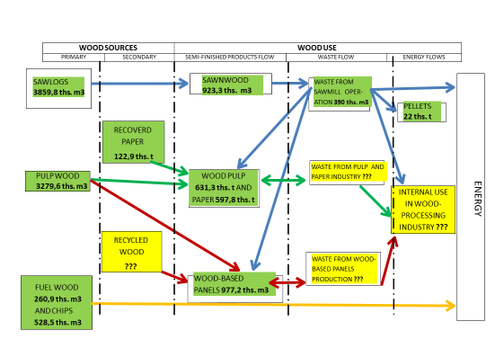
Basic simplified model of the actual wood use
A basic model is based on the actual/current state of wood use in the SR (in the listed structure).
It provides a reference basis for comparison with other wood use options.
Notes:
Following the mentioned analyses we have quantified the individual items of the simplified basic model of the actual wood use.
As regards quantification there are still missing some needed data (displayed by yellow colour) related mainly to volumes of: recycled wood, waste from pulp and paper industries, waste from wood-based panels industries and volume of woody material used in wood-processing industry for energy purposes. We will have to work on methods for obtaining the missing data.
This basic model provides a reference basis for ...

Slide 22
Proposal of optimal model(s) of sustainable wood utilization
Optimal (variant) models will be based on changes in wood utilization, as compared to basic (actual) reference model in order to ensure:
Optimal value utilization of the available structure of raw wood assortments;
Increase in domestic wood processing and consumption (export vs. domestic consumption);
Application of cascade wood use principles; generation of energy primarily from wood waste, residues or recycled products;
Improvement the carbon balance of the use of wood and sequestration of carbon in harvested wood products (HWP).
Notes:
The most important task of the next research will be the proposal of optimal models of Sustainable wood utilization. They will be based on...
Cascade utilization= use of wood raw material in a way that brings higher added value (priority use in construction, furniture production, long life cycle products); energy should primarily be generated from wood waste, residues or recycled products.

Slide 23
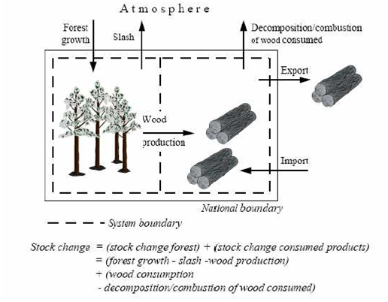
Carbon balance
Within the carbon balance the „Stock change approach“ is applied.
This approach evaluates the annual change of the carbon stock in HWP within the domestic consumption, it is: production + import - export.
Notes:
Within the carbon balance in research solution we apply the „Stock change approach“. This approach evaluates the annual change of the carbon stock in Harvested wood products ...

Slide 24
Estimation of carbon stocks and annual carbon stock changes in HWP pool:
It is calculated separately for each of the HWP fractions: „sawnwood“, „wood-based panels“ and „paper and paperboard“.
For this purpose, the first-order decay (FOD), which is a flux data method, in combination with estimates of half-lives is applied:
Where:
i = year C (i) = the carbon stock in the particular HWP category at the beginning of year i, Gg C
k = decay constant of FOD for each HWP category (HWPj) given in units yr-1 (k = ln(2)/HL, where HL is half-life of the HWP pool in years.
Inflow (i) = the inflow to the particular HWP category (HWPj) during year i, Gg C yr-1 ΔC(i) = carbon stock change of the HWP category during year i, Gg C yr-1.

Slide 25
Outcomes of estimation of carbon stocks and annual carbon stock changes in HWP pool
Positive values represent Greenhouse gas emissions
Negative values represent removals carbon from atmosphere
Values are expressed in Gg CO₂.year⁻¹
This method of carbon balance will be used in our project for formation of models of wood utilization that will lead to increasing of carbon stocks in harvested wood products.
Notes:
On this slide is displayed the outcome of estimation of ...

Slide 26
Thank you for your attention
Authors:
Martin Moravčík, National Forest Centre, moravcik@nlcsk.org
Miroslav Kovalčík, National Forest Centre, kovalcik@nlcsk.org
Vlastimil Murgaš, National Forest Centre, murgas@nlcsk.org
Hubert Paluš, Technical University Zvolen, palus@tuzvo.sk
Ján Parobek, Technical University Zvolen, parobek@tuzvo.sk

