Slide 1

Technical University in Zvolen Department of Economics and Management of Forestry Faculty of Forestry, Zvolen Slovak Republic
How Contractor Firms in the Slovak Forestry Service Sector Innovate?
- an Innovation System Perspective
Martina Štěrbová, Jaroslav Šálka, Zuzana Sarvašová

Slide 2

BACKGROUND
Innovation processes in traditional sector – harvesting, skidding and timber transport
The market of forestry services in Slovakia:
relatively new and young market, originated about 25 years ago
impulse for the creation: restitution process of returning of forest property and restructuring of state-owned enterprises
contractor firms - micro and SME
outsourcing of major forestry operations
quality of provided forestry services plays an increasingly important role
opportunities for innovations
_________________________________________________________________________________
How do Innovate Contractor Firms in the Slovak Forestry Service Sector?

Slide 3
Challenges
Innovation activity is LOW - limited to incremental, often only technological innovation
Innovation potential is HIGH - the current mechanisation is old and worn out - the need for changes and renewal = INNOVATIONS
Innovation barriers
lack of own financial resources
dominance of state forest enterprise
problematic public tenders
unstable market, uncertainty and sale ability risks
supply of services exceeds demand
low price of provided services
lack of job offers
_________________________________________________________________________________
How do Innovate Contractor Firms in the Slovak Forestry Service Sector?

Slide 4
Innovation system of the forestry service sector
a set of different institutions, actors and their interactions
influences innovation processes
institutional innovation support
should support innovation implementation
3 basic functions:
reduction of uncertainties by providing and exchange of information
management of conflict and risk and cooperation between the various actors
the provision of pecuniary and non-pecuniary incentives
_________________________________________________________________________________
How do Innovate Contractor Firms in the Slovak Forestry Service Sector?

Slide 5
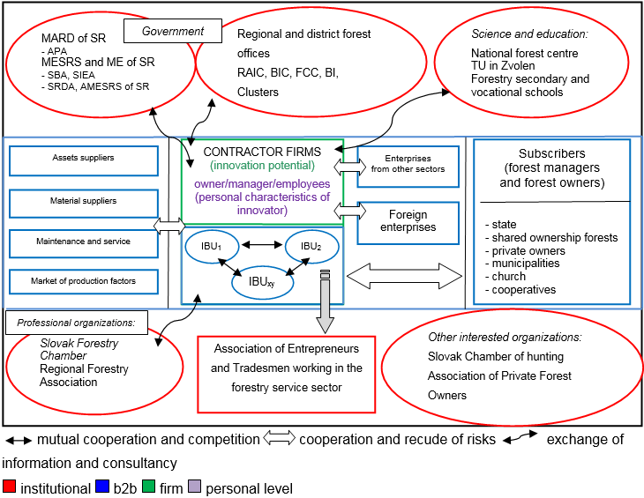
How does IS of the forestry service sector looks like?
_________________________________________________________________________________
How do Innovate Contractor Firms in the Slovak Forestry Service Sector?

Slide 6
AIM
to evaluate the functioning of the sectorial innovation system for innovation support
RESEARCH QUESTION
How innovation system in the Slovak forestry service sector fulfils its three basic functions for innovation support?
_________________________________________________________________________________
How do Innovate Contractor Firms in the Slovak Forestry Service Sector?

Slide 7
METHODOLOGY
Background information
Literature review
Questionnaire survey – 204 respondents
Collective case study – 13 case studies – the best practice technology
Innovation system analysis – a synthesis of the data acquired from the analyses of innovation system:
Individual features – contractor firms’ view
Literature review
SWOT analysis
Face to face interviews with contractors
Institutional system and support – institutionals’ view
Document analysis – Register of Financial Statements of the Ministry of Finance, The RDP 2007 – 2013 and 2014 – 2020
Interviews with experts from The Agricultural Paying Agency
_________________________________________________________________________________
How do Innovate Contractor Firms in the Slovak Forestry Service Sector?

Slide 8
RESULTS
contractors’ view
(i) information exchange
lack of cross-sectoral knowledge and links
lack of information for the reduction of uncertainties
state administration – not enough direct information and subsidies specialized in consultancy and knowledge transfer
(ii) cooperation
weak - mainly on an informal level
formal cluster does not exist
The Association of Entrepreneurs and Freelancers working in the Forestry Service Sector
coefficient of localization identifies the key regions suitable for the formal cluster in the sector
institutionals’ view
_________________________________________________________________________________
How do Innovate Contractor Firms in the Slovak Forestry Service Sector?

Slide 9
institutionals’ view
The key regions for the potential clusters¹
¹ Štěrbová et al. (2014)
_________________________________________________________________________________
How do Innovate Contractor Firms in the Slovak Forestry Service Sector?

Slide 10
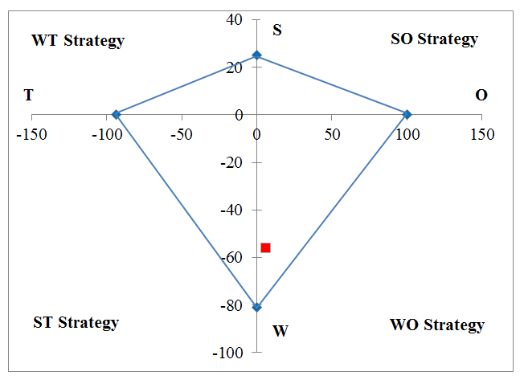
The innovation strategy²
Factors affecting innovation behaviour
SWOT analysis
O outweigh T
W outweigh S
contractors’ view
WO - an alliance strategy COOPERATION
information and knowledge of innovations
combination of the network and the vertical production chain
cluster of suppliers-to-customers chain
² Štěrbová et al. (2016)
_________________________________________________________________________________
How do Innovate Contractor Firms in the Slovak Forestry Service Sector?

Slide 11
Regional innovation paradoxes³
institutionals’ view
Košice Region
strategic area for cluster formation, but the negative values of investment innovations
Region Bratislava
small concentration of enterprises, but high amount of capital invested into innovations
³ Štěrbová et al. (2014)
_________________________________________________________________________________
How do Innovate Contractor Firms in the Slovak Forestry Service Sector?

Slide 12
(ii) management of conflicts and risks⁴
limited space
weak negotiating position = adaptation
problems - cutting of prices, termination of the contract
Contract terms and conditions
investments into innovations - if only 50 – 80 % of the investment will be paid back by the contract
long-term relationships and contracts
complex service delivery - own technology park
firms’ history increases its reliability and credibility
contractors’ view
⁴ Paluš et al. (2015)
_________________________________________________________________________________
How do Innovate Contractor Firms in the Slovak Forestry Service Sector?

Slide 13
(iii) the provision of pecuniary incentives⁵
Methods
RDP 2014 - 2020
Document analysis
Evaluation of appropriateness and effectiveness of the state intervention
Interviews with experts
Expert estimations
RDP 2007 - 2013
POLICY OUTPUT
POLICY IMPACT
Changes in target behaviour
POLICY OUTCOME
The overall changes in indicators
The formulation of forestry measures
institutionals’ view
Three levels of the evaluation of financial incentives from The Rural Development Programme
⁵ Štěrbová, Šálka (2016)
_________________________________________________________________________________
How do Innovate Contractor Firms in the Slovak Forestry Service Sector?

Slide 14
Policy output
The RDP 2007 – 2013 - not focused on supporting innovations
The RDP 2014 – 2020 - improved towards supporting innovations
(non-repayable grant, risky oriented, new ideas and pilot projects, focused on the contractor firms etc.)
Policy impact
contractors = not eligible applicants
condition to own or use at least 10 ha of forest land
a small change in their behaviour - rent a forest land
institutionals’ view
Policy outcome
only 0,01 % of total number of contractors obtained financial support from RDP 2007 – 2013
Financial incentives did not fulfil its function
for innovation support
_________________________________________________________________________________
How do Innovate Contractor Firms in the Slovak Forestry Service Sector?

Slide 15
CONCLUSION: innovation processes
dominate incremental, often only technological innovations new for the firms, not for the sector in general
current equipment is outdated and has a negative impact on the environment
innovations are done without much institutional support
there is no “one” innovation system supporting innovations within the forestry service sector
institutionalisation and systemic support is needed
_________________________________________________________________________________
How do Innovate Contractor Firms in the Slovak Forestry Service Sector?

Slide 16
CONCLUSION
The innovation system fulfils its three basic functions at insufficient level
Information
the innovation system does not provide enough information for the reduction of uncertainties, conflicts and risks
lack of knowhow
Cooperation
weak interactions
formal cluster does exist
informal level of cooperation
InceNtives - financing
financial support not focused on supporting innovations
_________________________________________________________________________________
How do Innovate Contractor Firms in the Slovak Forestry Service Sector?

Slide 17
CONCLUSION: support needs
The innovation process can be fostered by:
Information
Cross-sectoral information, knowledge, knowhow and links
Information measures – The RDP 2014 – 2020 - professional skills
cooperation
Cluster formation – the improvement and expansion of cooperation
Cross-sectoral networking
Long-term and clear contracts with the guarantees
Providing complex service delivery
Incentives - financing
External financial support – bank loans
Un-bureaucratic start-up and risky oriented innovation funds
Positive incentives for innovations from The RDP 2014 – 2020
_________________________________________________________________________________
How do Innovate Contractor Firms in the Slovak Forestry Service Sector?

Slide 18
Thank you for your attention!
Martina Štěrbová^{1,2}, Jaroslav Šálka¹, Zuzana Sarvašová²
¹ Department of Economics and Management of Forestry
Faculty of Forestry, Technical University in Zvolen
T. G. Masaryka 24, SK-96053 Zvolen, Slovak Republic
martina.sterbova1@gmail.com; salka@tuzvo.sk
² Department of Forest Policy, Economics and Forest Management
National Forest Centre – Forest Research Institute Zvolen
T. G. Masaryka 22, SK-96092 Zvolen, Slovak Republic
sterbova@nlcsk.org; sarvasova@nlcsk.org

