Slide 1
Non-wood forest products innovation patterns and support needs: an analysis of European case studies Gerhard Weiss, Alice Ludvig, Ivana Zivojinovic University of Natural Resources and Life Sciences, Vienna (BOKU) and European Forest Institute – Central East European Regional Office (EFICEEC) Case study material also from: G. Corradini, S. Mutke, T. Dickson, M. Wilding, V. Tahvanainen, J.-A. Bonet, A. Japelj, J. Nedeljkovic, V. Verdejo, M. Layos

Slide 2
Background:
NWFP and innovation
Non-wood forest products (NWFP) …
cover a broad range of market sectors (food-cosmetics-crafts-chem’s);
are often claimed to be a promising business field;
but are in fact often underestimated in their economic value;
and named „minor,“ „secondary,“ „ by-products,“ „niche-markets“ or even „non-market goods“ (Mantau et al. 2001; Mavsar et al. 2008)
In reality, they are often produced in the wake of timber production and not necessarily seen as a business opportunity. Thus there is hardly an innovation focus put on these products.

Slide 3
Innovation systems:
definition and models
Innovation systems (IS) comprise of:
actors, institutions (rules of the game),
and their interrelations.
Triple helix model (Etzkowitz and Leydesdorff, 2000):
Industrial system / firms
Education and research system
Government and governance
and their interrelations (!)
Quadruple helix model (Carayannis and Campbell, 2010):
plus: Public and civil society

Slide 4
Conceptual approach:
elements of analysis
Innovation system perspective:
understanding of innovation processes.
role of entrepreneurship;
role of institutional frameworks and policies in innovation support;
role of social developments.
Aim to derive NWFP innovation patterns.

Slide 5
Entrepreneurship
Two notions of entrepreneurship:
understanding as a personal trait/being an entrepreneurial person:
… “entrepreneurial spirit” (Schumpeter); pursue opportunity (Stevenson); risk-taker (Drucker), innovativeness and responsibility …
starting up or running a business, owning a company:
… opportunity-driven or necessity-driven entrepreneur;
In practice, many personal histories/motivations to become entrepreneur.
“…hardly anybody starts a business in order to achieve innovation, job creation, or economic growth…” but rather for their “personal desire for profit and autonomy” (Hessels et al., 2008).

Slide 6
Institutional frameworks
Have different roles in innovation systems:
direct roles: offer advisory services or innovation and start-up funds;
indirect roles: research, education and training, regulatory and administrative systems.
In NWFP, specific institutional frameworks and support is mostly lacking because NWFP are neglected by forestry or agricultural ISs.
Certain support by rural or regional development agencies/programmes.
Formation of specific associations important for scaling up and diffusion (e.g., The Arctic Flavours Association, FI; Scottish Wild Harvests Association; truffle growers’ associations, etc. ).

Slide 7
Social developments
With NWFP we see fundamental social changes in rural areas:
in former times, NWFP were part of the traditional agricultural land uses, farm structures and subsistence needs of the rural population;
today , NWFP are connected to new urban demands.
Examples for social trends and marketing opportunties:
Natural quality: lifestyle of health and sustainability (“LOHAS”);
Retro quality: Traditional, home-made and hand-manufactured food or handicraft products, with local culture or old traditions;
Experiential quality: growing demands for entertainment and “experiences” (“experience economy”).

Slide 8
Challenges and opportunities
A limited marketability because of an often public good character of the products (Mantau et al., 2001; Mavsar et al., 2008);
a limited attention of established sectoral innovation systems, thus only limited support or even barriers (Rametsteiner et al., 2005; Weiss et al., 2011; Buttoud et al., 2011).
to connect rural knowledge and traditions with new urban demands, to create innovations and new businesses (StarTree; COST Action FP1203).

Slide 9
Research questions
1. How do innovations in non-wood forest products happen – in a situation where there is rather limited institutional innovation support? (“ European NWFP innovation patterns”)
2. How are those innovations supported by the institutional system and what are their support needs?

Slide 10
Aims and methods of this paper
Aims:
to analyse innovation patterns in NWFP in Europe;
to derive innovation support needs for NWFP.
Methods:
12 case study regions across Europe;
Questionnaires to relevant organisations for supporting innovation processes; interviews with innovators and involved actors;
→ in-depth analyses of innovation processes in 20 innovation cases.

Slide 11
The innovation cases
Product Innovations | “Cairn O´Mohr“ (UK, Scotland): wine from oak-leaves and elderberries
 | “Fine Pluck” (UK, Wales): hand-plucked tea
Institutional Innovations | “Nature Park Specialities” (AT): wild food specialities
 | “Xeis Edelwild” (AT): marketing of deer
 | “Wild vom Förster” (DE): marketing of deer
Historical/ Traditional Innovations | “Resinas naturals” (ES): natural resin
 | “Servizio di raccolte resine” (IT): natural resin
Innovations with “embedded” products | “LEADER Region Zirbenland” (AT): Pine products
 | „Out to Learn Willow“(UK, Wales): willow weaving courses
 | “Vale die Castione” (IT): Chestnut association and events
Service Innovations | “Wild Pickings” (UK, Wales): foraging products and tours
 | „Woodland Skills Center“ (UK, Wales): teaching woodland management
 | “Christmas Tree Marketing” (AT): cut your own tree
 | “The Monegal Mushroom Hotel” (ES, Catalonia):
Marketing Innovations | “Del Monte de Tabuyo” (ES) gourmet products from mushrooms:
 | “Adonis company” (SRB): tea spoon shaped bags
 | “Finnish Gift Firm” (FI): luxory gift packages
Technical innovations | “Birch Sap Company” (FI)
 | Trentino Firm (IT): domesticating mushrooms
 | “Wooden Knots for Climbing Walls“ (SLO): wooden climbing holds

Slide 12
Analysis questions
Type of company: large (LALO), traditional (TRALO), or new forest owner (NEWLO), single enterpreneur (ENTR), industrial company (IND), social enterprise (SOC), institutional actor (INST).
Geographical sphere of knowledge/ideas: rural, urban, or mixed.
Initiation from which sectoral sphere: forestry, cross-sectoral, outside.
Type of support – which sector: forestry, rural development, or non-sectoral (start-up/industrial development).
Type of support – which level: local-regional, national, or Europe/EU.
Type of support – which function: information, financing, co-ordination.
→ Innovation pattern and support needs?

Slide 13
Type of company
Type of innovating company
LALO | 2 | ENTR | 11
TRALO | 1 (3) | SOC | 2
NEWLO | (2) | IND | 1
 |  | INST | 3

Slide 14
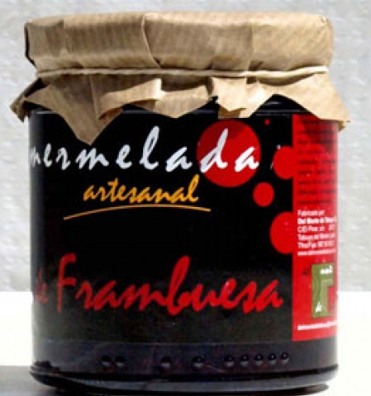
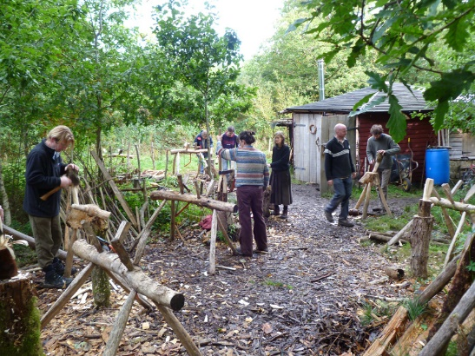
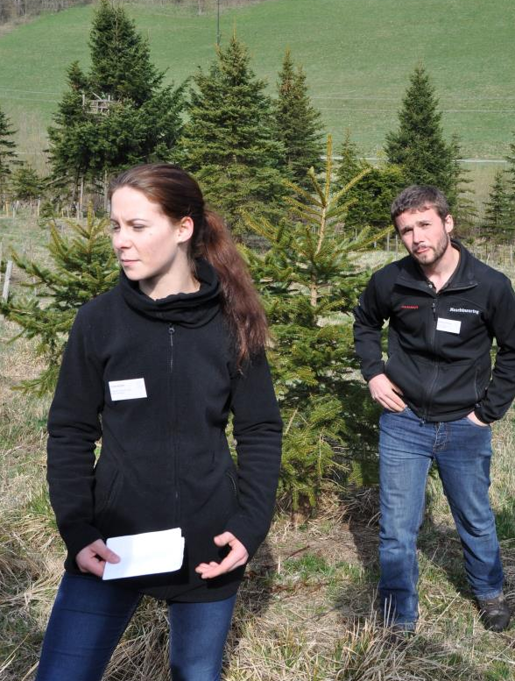
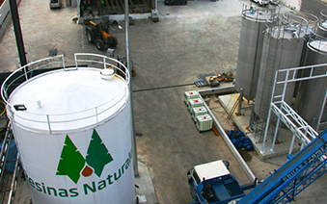
Type of company
Type of innovating company
LALO | 2 | ENTR | 11
TRALO | 1 (3) | SOC | 2
NEWLO | (2) | IND | 1
 |  | INST | 3

Slide 15
Geographical sphere of knowledge/ideas
Source of ideas
Rural | 6
Urban | 7
Rural + urban | 7

Slide 16
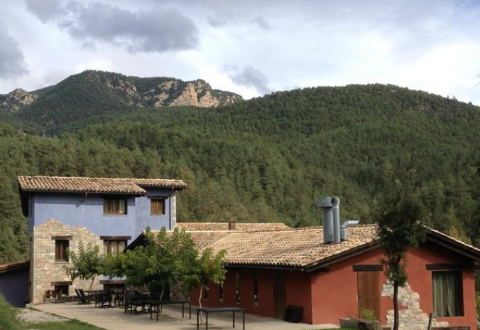
Geographical sphere of knowledge/ideas
Source of ideas
Rural | 6
Urban | 7
Rural + urban | 7
Muchroom hotel
Stylish sparkling birch sap

Slide 17
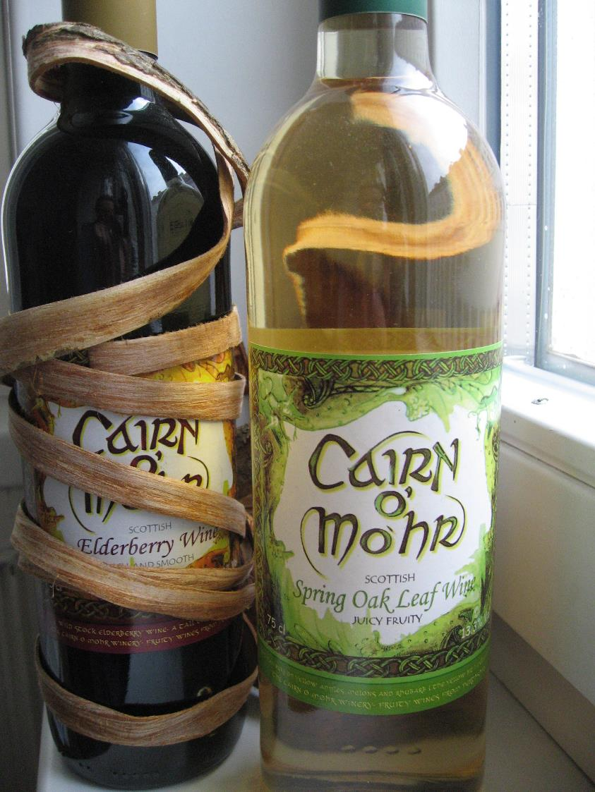
Initiation from which sectoral sphere
Initiation from which sector
Forestry | 1
Cross-sectoral | 11
Outside forestry | 8

Slide 18
Type of support – which sector
Support – from which sector
Forestry | 2
Rural development | 10
Non-sectorial | 10

Slide 19
Type of support – which sector
Support – from which sector
Forestry | 2
Rural development | 10
Non-sectorial | 10
Support
Initiation | Forestry | RD | Non-sect.
Forestry | 1 | - | - | (1)
Cross-sect. | 1 | 8 | 4 | (13)
Outside | - | 2 | 6 | (8)
 | (3) | (10) | (10)

Slide 20
Type of support – which level
Support – from which level
Local-regional | 13
National | 5
National - local implementation | 5
European/EU | 1
EU - local implementation | 5

Slide 21
Type of support – which function
Support – which function
Information | 15
Financing | 18 (10)
Co-ordination | 10
Significance for entrepreneurs
Information | +++
Financing | +
Co-ordination | ++
Regulatory | 1

Slide 22
Innovation patterns and support needs
HAVE | NEED
Forest company-driven
In-house capacities | Classical innovation management; R&D funds
Forest owner-driven
Entrepreneurship | Info+fin+co-ord; cross-sectoral links
Entrepreneurial-driven
Entrepreneurship | Info+fin+co-ord; cross-sectoral links
Industry-driven
Investment capital | Regional cross-sector platforms; R&D funds
Social enterprise-driven
Voluntarism; social engagement | Public support and specific funds
Regional development-driven
Regional development orientation | Open framework and support structures

Slide 23
Conclusions: innovation processes
Small-scale innovations and entrepreneurship dominate and do without much institutional support (Ludvig et al. 2016a);
There is no “one” innovation system supporting non-timber products; support comes from various sources but is rare;
For none of them, NWFP are central;
Break-through innovations and scaling-up need institutionalisation and systemic support (for: R&D, networking; awareness raising; regulatory adaptations; …) → “institutional innovations” (Ludvig et al. 2016b).

Slide 24
Conclusions: support needs
Information:
Technical AND business knowhow
cross-sectoral knowledge and links
R&D
Financing:
Small, un-bureaucratic start-up funds for entrepreneurs
large R&D funds for industrial scale investments
Co-ordination:
For: information, funding, business co-operation, conflict resolution, regulatory adaptions, and public awareness!

Slide 25
Top-down support for
bottom-up innovations
→ open and flexible support programmes AND
systemic structures for tailor-made support.
Explicit sectoral innovation policy, including information measures, cross-sectoral networking and risk-oriented innovation funds (seed money) – „regionally networked IS“ (Asheim, 1998);
Rural development agencies offer such systemic support, e.g.:
LEADER regions
Cluster organisations
Triple (quadruple) helix / cross-sectoral platforms …

Slide 26
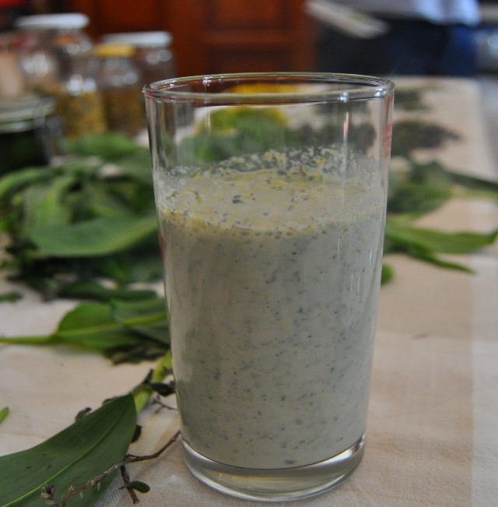
THANK YOU for your attention!
www.boku.ac.at
www.star-tree.eu
www.eficeec.efi.int
http://www.nwfps.eu/

